Slide 1
Recipient:
<contact list>
Message:
Send
Save
Cancel

Slide 2
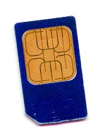
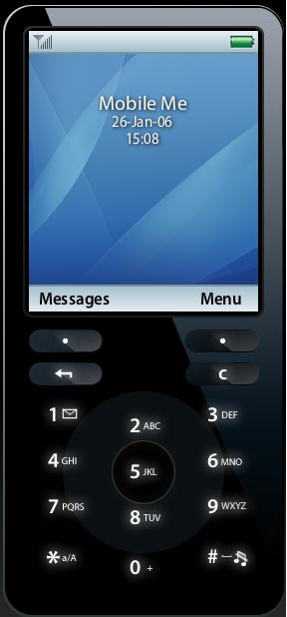
Group by saved location
Group by group
朋友
…
…
家人
同事
其他
…
…
…

